Slide 1
PSO Week 13
CS448 Staff

Slide 2
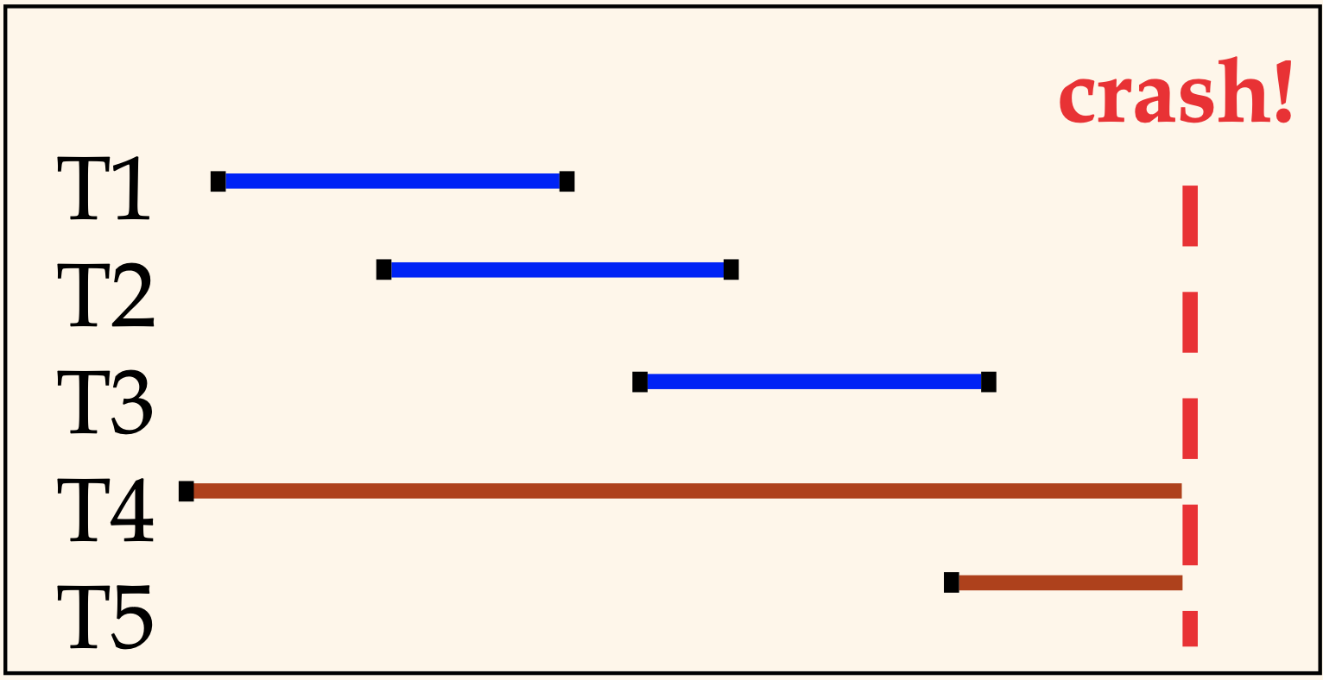
Motivation
Atomicity
All actions in transaction happen, or none happen
Transactions may abort (rollback)
Durability
If transaction commits, its effects persist
What if DBMS stops running?
The Recovery Manager guarantees Atomicity and Durability
Desired behavior after system restarts
T1, T2, T3 should be durable
T4, T5 should be aborted (effects not seen)
Reference: Database Management Systems, 3rd ed.

Slide 3
Basic Idea: Logging
Record UNDO and REDO information for every update in a log
Sequential writes to log (put it in separate disk)
Minimal info (diff) written to log
multiple updates fit in a single log page!
Log – an ordered list of REDO / UNDO actions
Log record contains: transaction ID, page ID, offset, length, old data, new data
and additional control info
Reference: Database Management Systems, 3rd ed.

Slide 4
Write-Ahead Logging (WAL)
The Write-Ahead Logging Protocol:
Must force the log record for an update before the corresponding data page gets to disk
Must write all log records for a transaction before commit
#1 enables Atomicity
#2 enables Durability
How is logging (and recovery) done?
Use the ARIES algorithm
Reference: Database Management Systems, 3rd ed.

Slide 5
WAL and the Log
Each log record has a unique Log Sequence Number (LSN)
LSNs are always increasing
Typically an offset from beginning of log file to allow fast access
Each data page contains a pageLSN
The LSN of the most recent log record for an update to that page
System keeps track of flushedLSN
The max LSN flushed so far
WAL: Before a page is written
pageLSN ≤ flushedLSN
Reference: Database Management Systems, 3rd ed.

Slide 6
Other Log-Related State
Transaction Table
One entry per active transaction
Contains transaction ID, status (running/committed/aborted), and LastLSN
Dirty Page Table
One entry per dirty page in buffer pool
Contains recLSN – the LSN of the log record which first caused the page to be dirty
Set to current end of log when a page is inserted into dirty page table (just before being updated)
Recorded in checkpoints, helps to minimize redo work
Reference: Database Management Systems, 3rd ed.
Notes:
Transaction Table – one entry for each active transaction
Transaction ID
Status – running / committed / aborted
LastLSN – the LSN for the transaction’s last log record (transaction can have multiple log records)
Dirty Page Table – one entry per dirty page
recLSN – LSN of log record that 1st caused page to be dirty
Set to current end of log when a page is inserted into dirty page table
Recorded in checkpoints, helps to minimize redo work

Slide 7
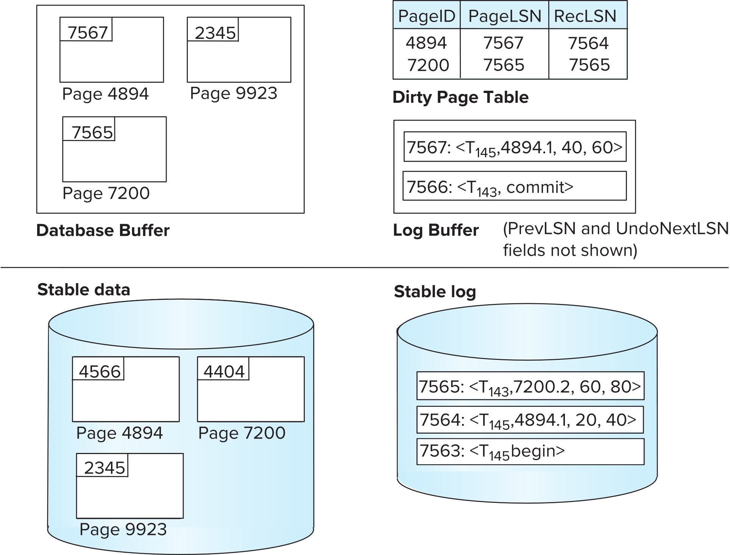

ARIES Data Structures
LSN: < $T_{i}$, PageID.Offset, $V_{1}$, $V_{2}$>
7565
(“log tail”)
(“log tail”)
flushedLSN
Adapted from: Database System Concepts, 7th ed. (textbook)

Slide 8
Example of Recovery
RAM
LSN | Log
00 | Begin checkpoint
05 | End checkpoint
10 | Update: T1 writes P5
20 | Update: T2 writes P3
30 | T1 abort
40 | CLR: Undo T1 LSN 10
45 | T1 End
50 | Update: T3 writes P1
60 | Update: T2 writes P5
 | CRASH, RESTART
Transaction Table
lastLSN
status
Dirty Page Table
recLSN
flushedLSN
ToUndo
PrevLSN
Reference: Database Management Systems, 3rd ed.

Slide 9
Example of Recovery
RAM
LSN | Log
00 | Begin checkpoint
05 | End checkpoint
10 | Update: T1 writes P5
20 | Update: T2 writes P3
30 | T1 abort
40 | CLR: Undo T1 LSN 10
45 | T1 End
50 | Update: T3 writes P1
60 | Update: T2 writes P5
 | CRASH, RESTART
70 | CLR: Undo T2 LSN 60
80 | CLR: Undo T3 LSN 50
85 | T3 End
Transaction Table
lastLSN
status
Dirty Page Table
recLSN
flushedLSN
ToUndo
UndoNextLSN
Reference: Database Management Systems, 3rd ed.

Slide 10
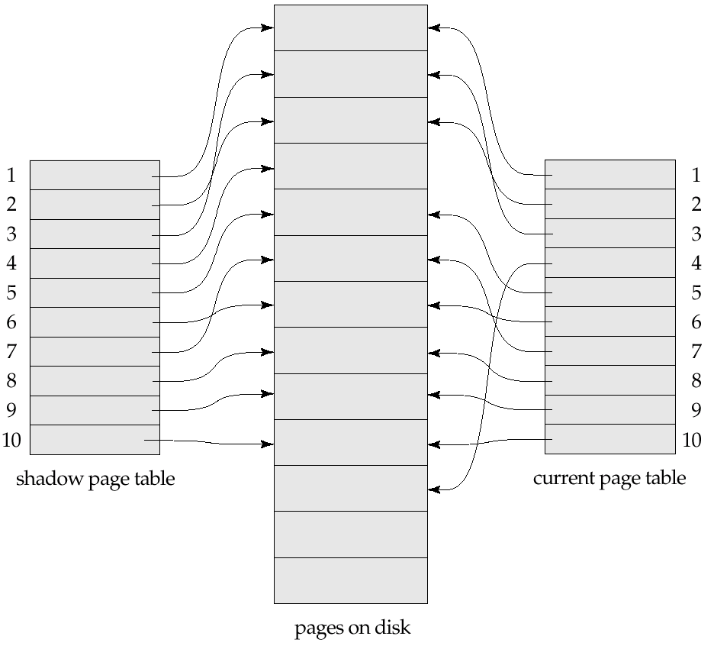
Shadow Paging
Idea: maintain two page tables during the lifetime of a transaction – the current page table, and the shadow page table
Store the shadow page table in nonvolatile storage
table is never modified during execution
To start with, both the page tables are identical.
Whenever any page is about to be written for the first time:
A copy of this page is made onto an unused page
The current page table is then made to point to the copy
The update is performed on the copy
Reference: Database System Concepts, 7th ed. (textbook)

Slide 11
Example of Recovery
shadow page table
pages on disk
current page table
(not updated)
P1 (Old)
P3 (Old)
P2
P4
P5 (Old)
P3 (New)
P1 (New)
P5 (New)
(after updating P3, P1, P5)
T3 writes P1
T2 writes P3
T2 writes P5
Crash happens before commits!
Recovery:
nothing to do!
free blocks

Slide 12
Example of Recovery
Commit transactions:
shadow page table
pages on disk
shadow page table
(not updated)
P1 (Old)
P3 (Old)
P2
P4
P5 (Old)
P3 (New)
P1 (New)
P5 (New)
T3 writes P1
T2 writes P3
T2 writes P5
Crash happens after commits
free blocks
Recovery: nothing to do!

Slide 13
Shadow Paging (Cont.)
To commit a transaction:
1. Flush all modified pages in main memory to disk
2. Output current page table to disk
3. Make the current page table the new shadow page table
Update the pointer to point to current page table on disk
Transactions are now committed
No recovery is needed after a crash — new transactions can start right away, using the shadow page table.
Pages not pointed to from current/shadow page table should be freed (garbage collected).
Reference: Database System Concepts, 7th ed. (textbook)

Slide 14
Shadow Paging (Cont.)
Advantages:
no overhead of writing log records
recovery is trivial
Disadvantages:
Commit overhead is high Example: 10 small transactions that update different pages
Shadow Paging – Need to flush all 10 pages!
Better for big changes
Logging – All 10 transactions probably fit in a page
Better for small changes
Data gets fragmented (related pages get separated on disk)
Need to garbage collect pages containing old versions of modified data
Reference: Database System Concepts, 7th ed. (textbook)

Slide 15
References
Database System Concepts, 7th ed. (textbook) Abraham Silberschatz, Henry F. Korth, S. Sudarshan
Ch. 19 [slides]
Database Management Systems, 3rd ed. R. Ramakrishnan and J. Gehrke
Ch. 18 [slides]
Additional references:
https://www.geeksforgeeks.org/database-recovery-techniques-in-dbms/
https://www.geeksforgeeks.org/log-based-recovery-in-dbms/
https://www.geeksforgeeks.org/shadow-paging-dbms/

